Slide 1
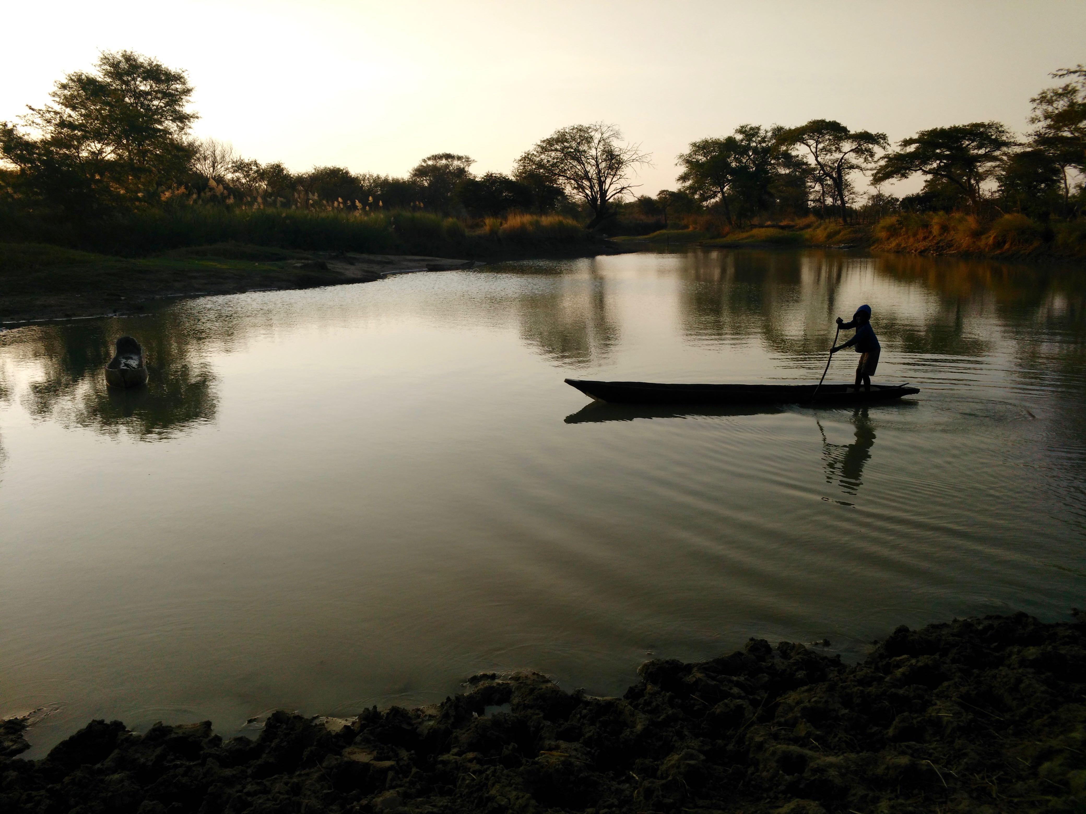
Anticipating Disaster:
Local Dependence on Formal Climate Information vs. Traditional Ways of Knowing
Sierra Gladfelter
Geography Department
University of Colorado Boulder
Notes:
This research was conducted to strengthen ongoing programming of ZRCS through an examination of barriers to and opportunities for climate adaptation as identified by key stakeholders and local residents in the Kazungula district of the Southern Province of Zambia.
The specific goals of this research have been to:
1) detail current barriers that communities face both in coping with and adapting to climate-induced disasters
2) identify potential culturally-appropriate and feasible mechanisms for communication to improve access to early warnings and enhance preparedness.
The hope is that this information will assist the ZRCS in supporting ongoing preparedness activities in these communities and in developing new proposals that consider opportunities for building climate resilience through feasible data sharing and improved upstream-downstream linkages.

Slide 2
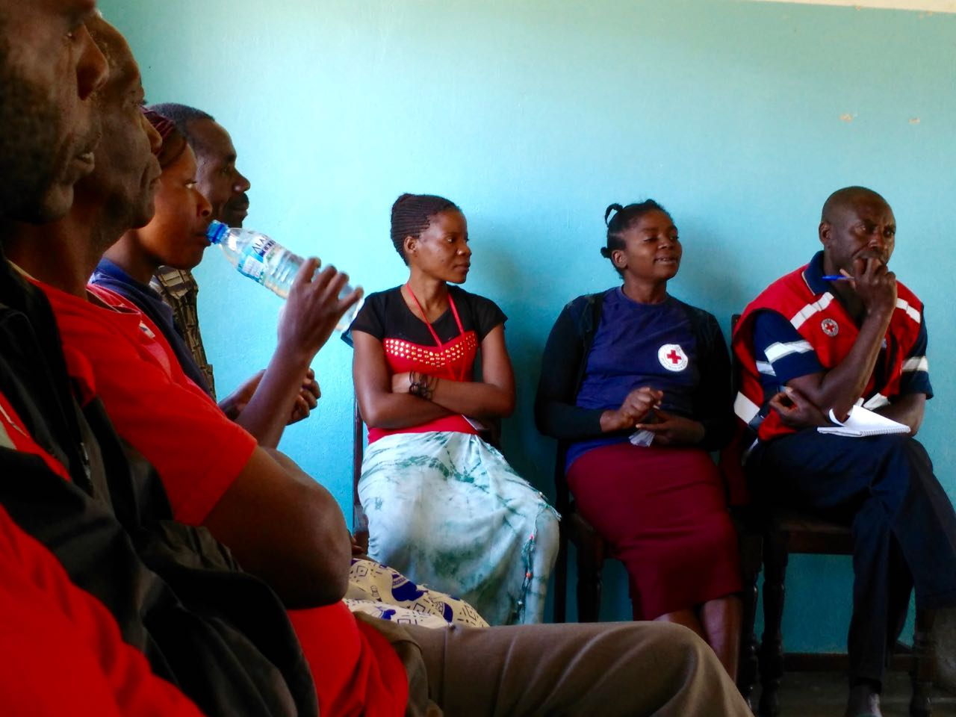
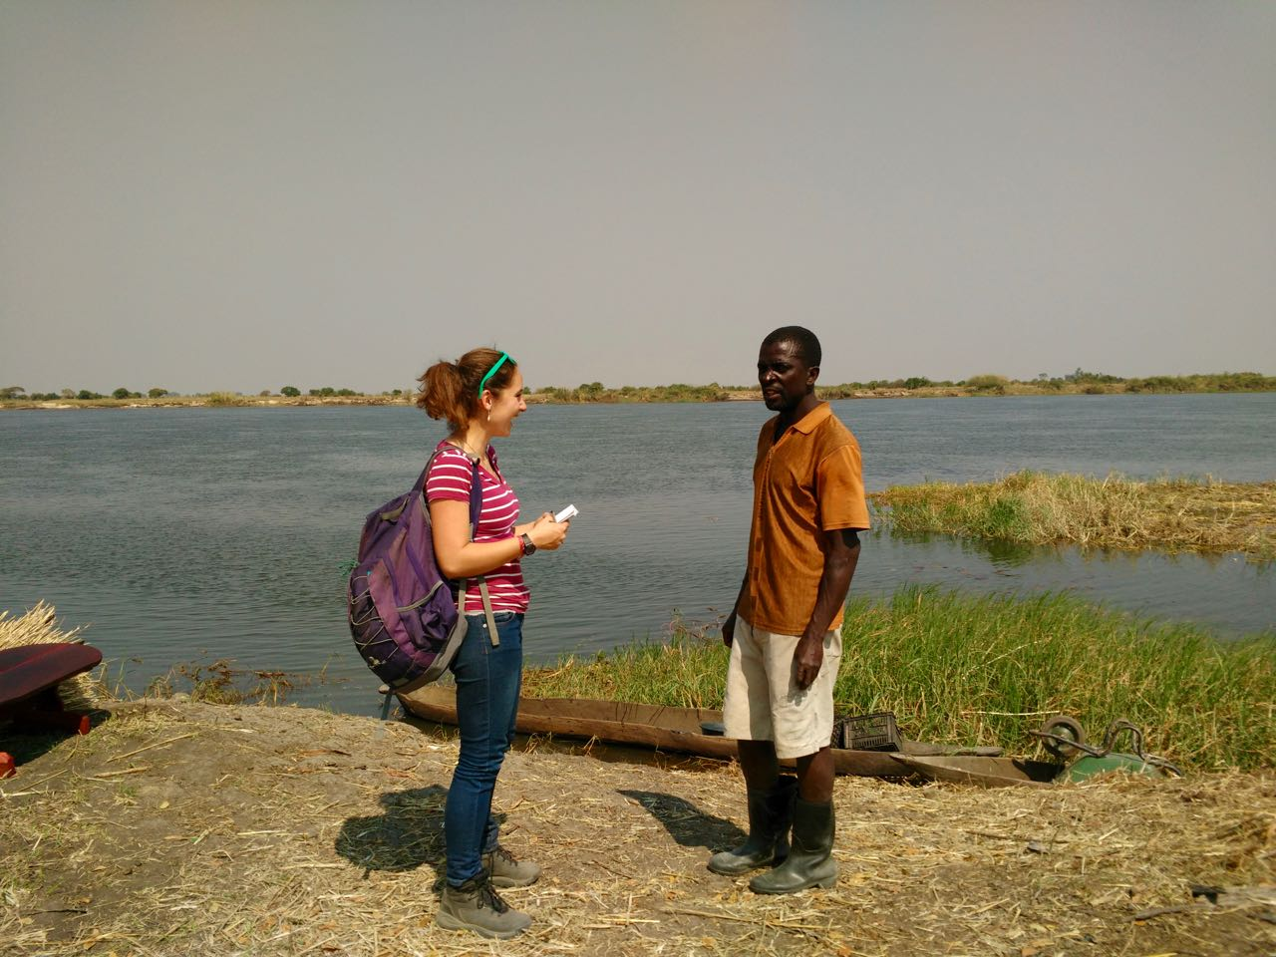
Methodology
Notes:
Two weeks of qualitative data collection using purposeful sampling in communities located in Kazungula District, Southern province
Focus Groups with Key Stakeholders (3)
-3 focus groups with Kawewa, Sikaunzwe and Kasaya SDMCS located in Kazungula
2) Interviews (13)
-8 interviews with key stakeholders and community members (i.e. lead farmers, SDMC members, gauge readers, residents trained in formal early warning programs)
-4 interviews with informants at key institutions at district/regional officers (i.e. Department of Water Affairs, regional officer for Zambia Meteorological Department, Community Based Natural Resource Management Platform, Agriculture Extension officer)
-1 interview with informant at national level office in Lusaka (Water Resource Management Authority)
3) Participant observation of ZRCS Evaluation and Monitoring of existing interventions
4) Site visits in the field and photo documentation exposure and adaptive strategies
Transportation Constraints/Challenges that compromised more extensive data collection

Slide 3
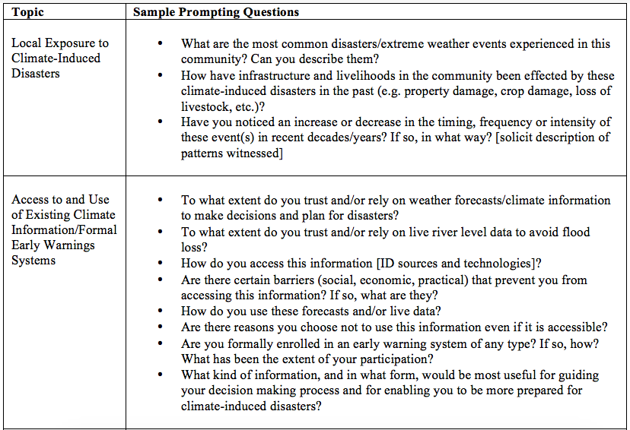
Notes:
Sample interview/focus group questions from questionnaire

Slide 4
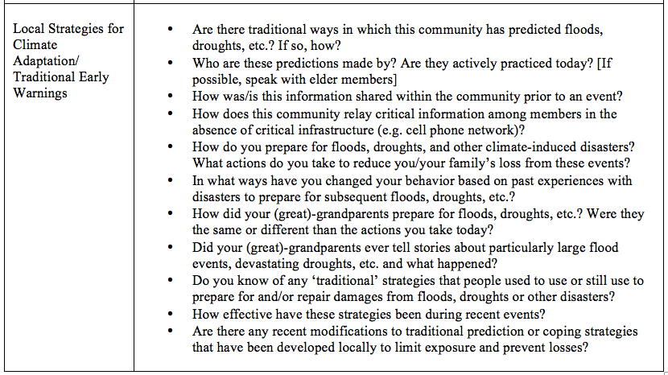
Notes:
Sample interview/focus group questions from questionnaire

Slide 5
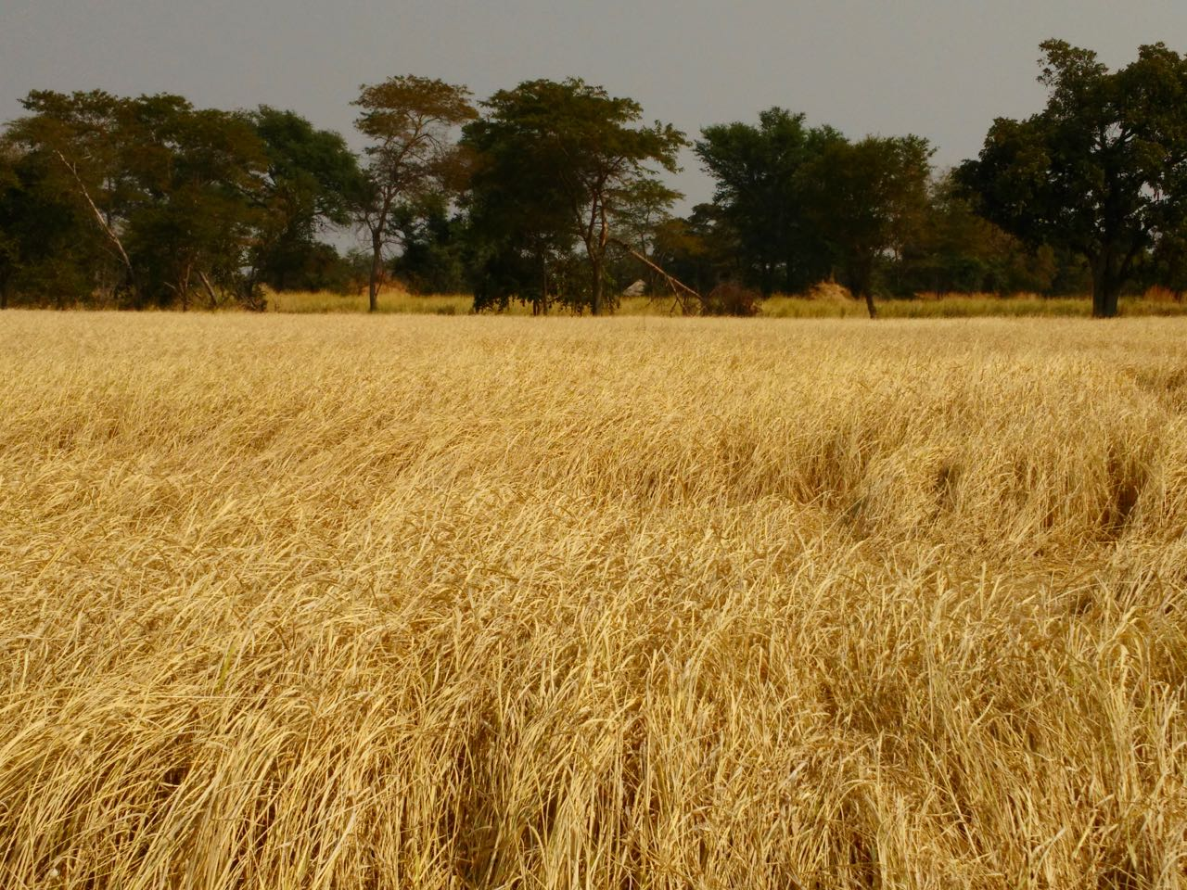
Findings and Analysis
Notes:
Communities increasingly suffering from climate induced disasters, alternatively being struck by droughts and floods
In the following sections, I provide an overview of
1) The primary disasters that residents face
2) Local strategies for coping with floods and droughts
3) Local Access to formal weather and climate information that may guide these actions and barriers to its dissemination
4) Traditional mechanisms for predicting disasters in the absence of formal data
5) Community perspectives on the utility of each source of information
I also analyze existing interventions to institute formal early warning systems in the region and document existing informal structures for relaying critical information from upstream. This part of my analysis deals with:
1) The limits of existing interventions to institute EWSs
2) A description of existing community-initiated EWSs that already function on the ground
3) Traditional strategies for exchanging critical information

Slide 6
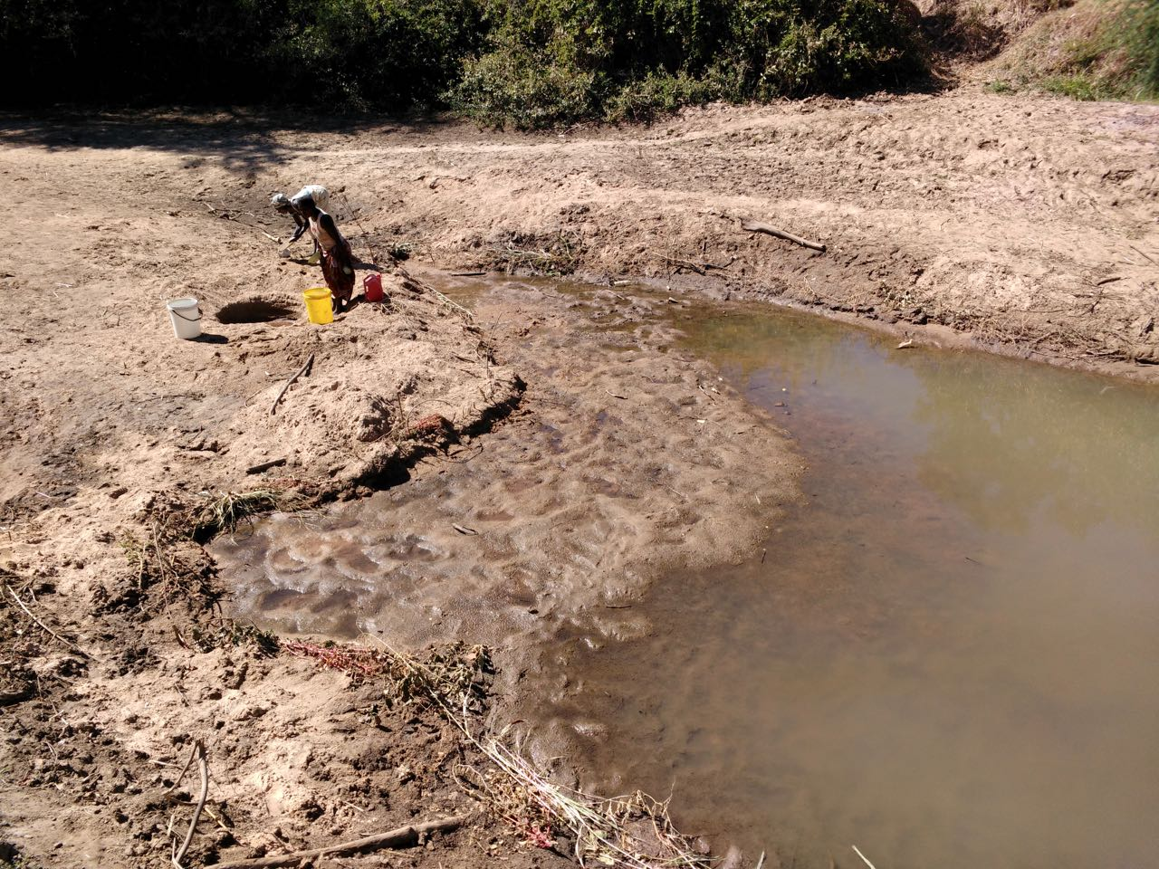
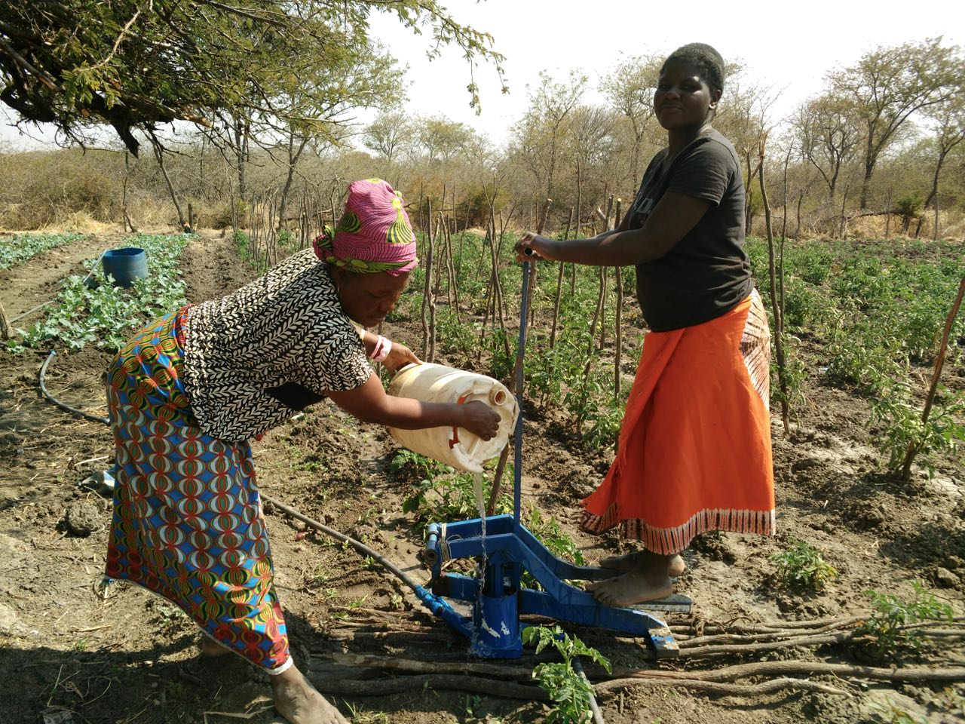
Climate-Induced Disasters Impacting Communities
Droughts
Notes:
Droughts and floods consistently cited as the two most common disasters across Kazungula
These events impact rural populations through property and crop loss, associated starvation, and the outbreak of diseases among both human and livestock populations due to compromised drinking water sources and waterlogged pastures in the aftermath of floods.
Residents stressed droughts as the worst disaster they face and noted an increase in the intensity and extent of dry spells.
This may be a reflection of their most immediate experience, as the past two to three years have been characterized by severe water stress, while there have not been any major floods in the region in several years.
However, local experiences with growing water stress reflect both regional climate predictions and documented trends of increasing temperatures and a reduction in overall precipitation for Zambia’s southern region.

Slide 7
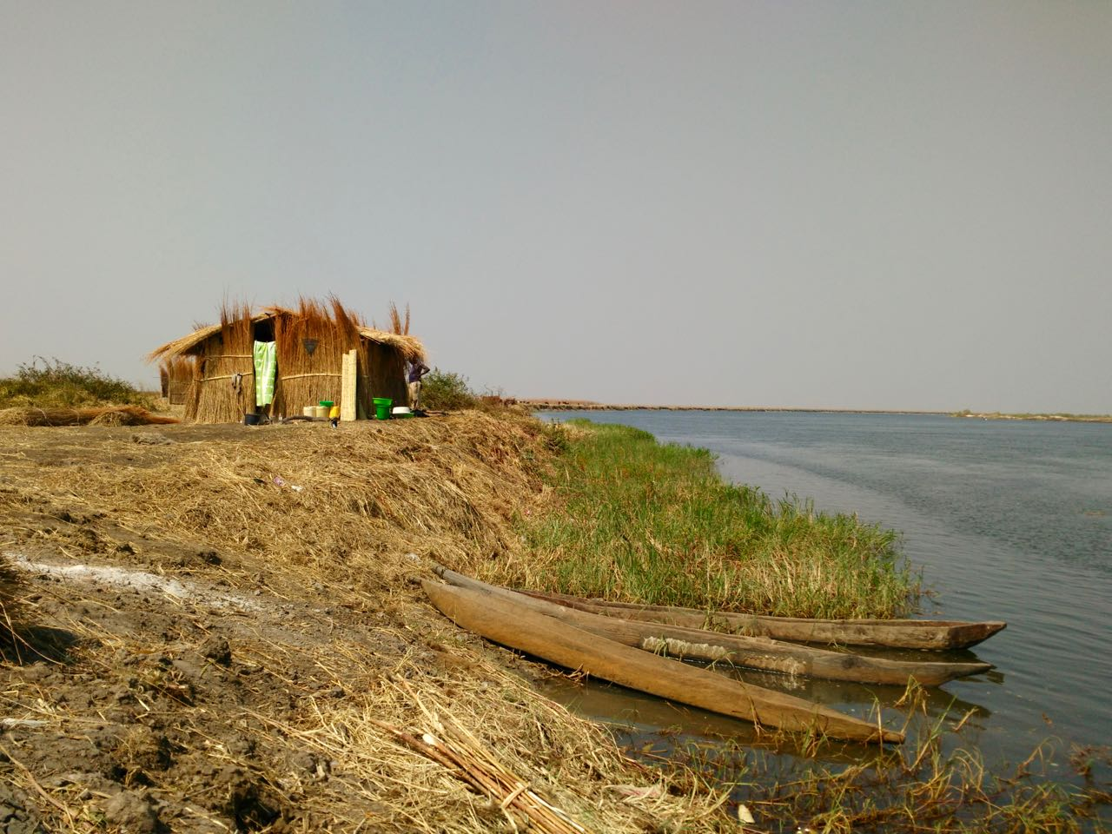
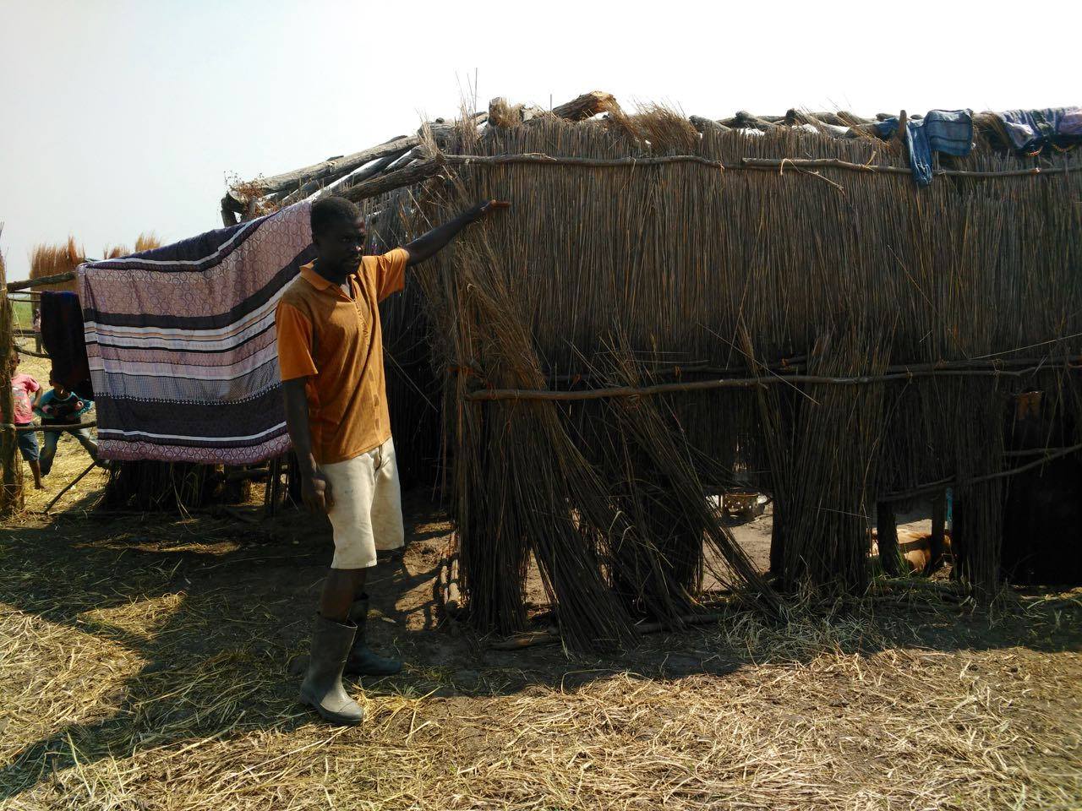
Floods
Notes:
Floods, which frequently strike all communities included in this study, are experienced more unevenly than drought.
While some communities are flooded by the Zambezi River directly, or the backlogging of tributaries that feed it, others primarily experience flash flooding on tributaries due to rainfall in the upstream.
Villages in Kawewa, for example, are more likely to witness gradual flooding and waterlogging that rarely causes violent destruction of life and property, while people living in Sikaunzwe are more likely to face flash flooding on small streams.
In Kasaya, where people live in much closer proximity to the Zambezi River, household and property loss to flooding has historically been higher.
Unlike droughts which were strictly described in terms of their negative impacts, people also recognized the positive role that floods play in fishermen’s livelihoods as well as in supporting soil fertility on the floodplain.

Slide 8
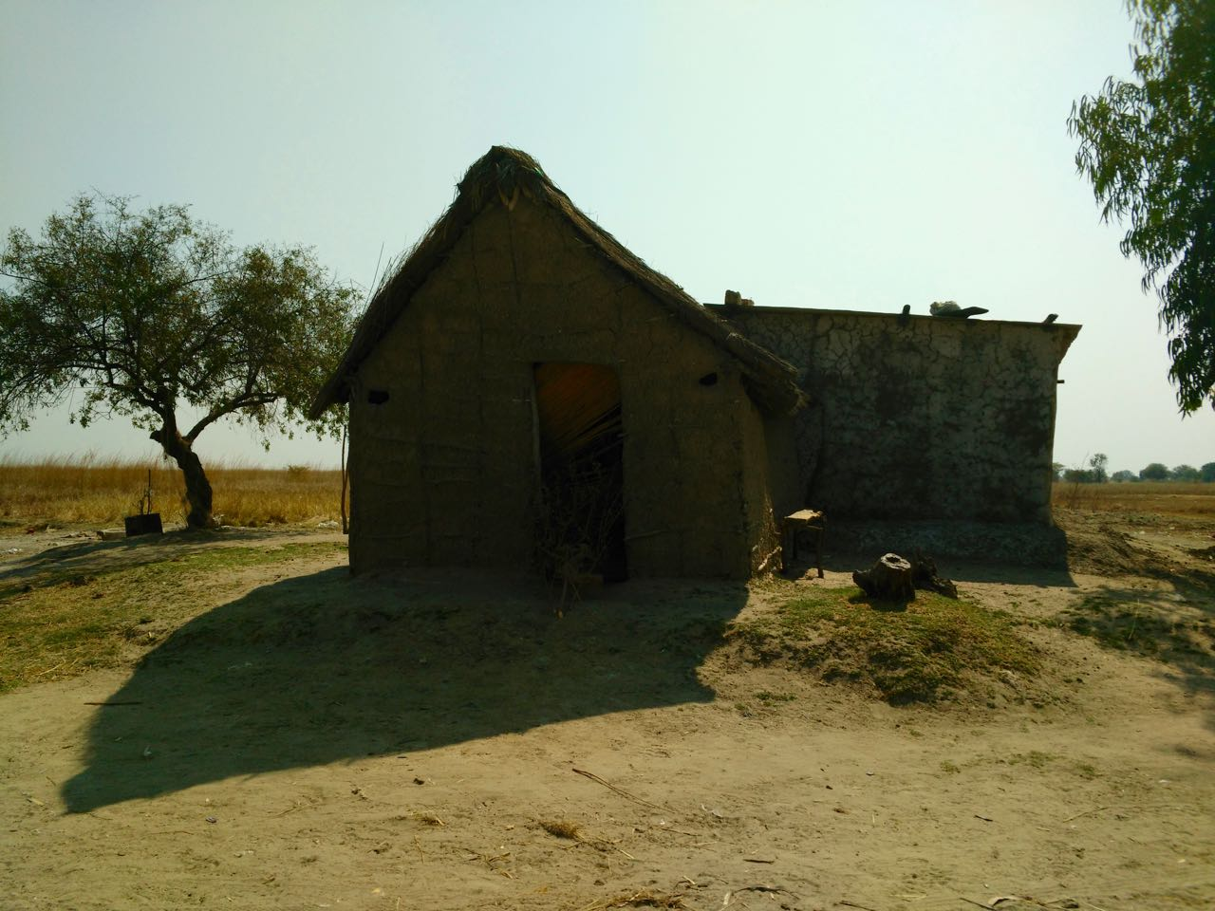
Local Coping Mechanisms and Adaptation
Strategies
Agricultural Adaptive Strategies
Temporary or Seasonal Relocation
Structural Reinforcement
Limits of these Actions
Notes:
AGRICULTURAL ADAPTIVE STRATEGIES
-primary actions based on seasonal forecasts (both formal and informal)
1. Crop Selection
Farmers will select either late, medium, or early maturing crop varieties based on anticipated rainfall for the growing season. When expecting particularly low levels of precipitation, some farmers will also choose to plant specific drought-resistant crops such as sorghum and bulrush which were grown indigenously in the region.
2. Adjusting the Timing of Planting
3. Keeping Fields in both Upland and Lowland
One method that farmers in Sikaunzwe described using, was where each household keeps fields in both the upland and lowland. While the upland fields are never lost to inundation, the fields located in the floodplain tend to do better during droughts and also typically have more fertile soils due to period nutrient addition during floods. Some farmers described planting the same crops in both their upland and lowland fields, while others selected different varieties based on their capacity to thrive in dry or wet conditions.
4. Constructing Earthen Ridges and Digging Furrows to Protect Crops from Floods
Since most households have maize planted in their lower fields during the time of the rainy season, people secure their crops from floods by constructing earthen ridges around their fields. Although these are present year-round, when villagers anticipate an impending flood, they go straight to their fields to reinforce these structures with additional soil. In addition to these ridges, farmers also described digging furrows to drain any fields that become submerged in floodwaters in order to prevent crop loss due to waterlogging.
TEMPORARY OR SEASONAL RELOCATION
In addition to agricultural adaptations, most residents described seasonal or temporary relocation as a commonly practiced adaptive strategy.
For floods:
-seasonal shifting to upland for cattle grazing.
-construction of permanent and/or temporary structures in the upland
-fishing camps along the Zambezi River retract to permanent villages annually where they live in homes elevated on humps of soil
-during major floods, the whole community will move to higher ground, either in upland areas of the bush or on the elevated tarmac road, where there is greater accessibility to relief.
For droughts:
-similar migration occurs but to river during the dry season, particularly water levels in streams and ponds drop significantly
-households move with livestock
-some supplement livelihood with fishing
STRUCTURAL REINFORCEMENT
-actions that people can take to secure their homes is generally limited to basic reinforcement with wooden poles
LIMITS TO THESE ACTIONS
-Most of these actions must be taken in the absence of formal forecasts
-Besides seasonal forecasts provided by the ZMD to guide agricultural decision-making, people rely strictly on their own traditional knowledge

Slide 9
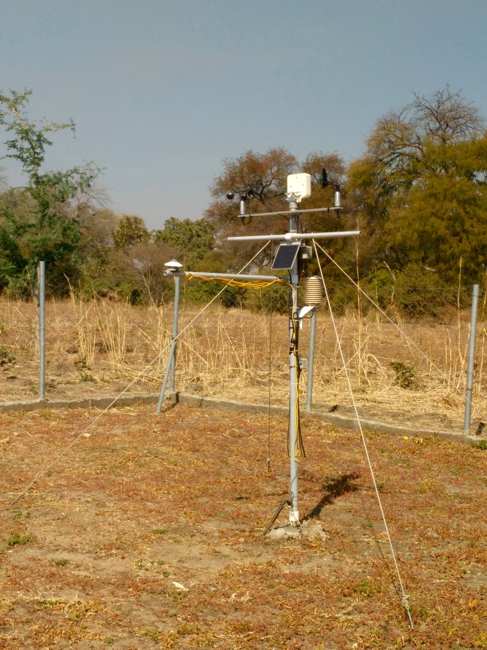
Local Access to Formal Weather and Climate Information
Notes:
Formal Forecasts: 3 types of advisories disseminated electronically
-Currently the ZMD distributes three types of forecasts including six-month seasonal forecasts with detailed information on how weather and climatic patterns like El Niño and La Niña will influence rainfall over the region, as well as 10-day and daily forecasts.
-however, only seasonal forecasts consistently reach communities
-Upon preparation at the central office, these forecasts are disseminated by email to key stakeholders such as ZRCS Disaster management staff, agriculture extension officers, local government officials and individuals who formally request to be added to the department’s list.
Barriers to Dissemination
-only seasonal forecasts consistently make it to the ground via pamphlets distributed by ZMD and agriculture extension officers
-burden of dissemination on agricultural extension officers who serve as intermediaries and translate advisories into local actions
-these individuals have rare access to email, intermittent cell service, and profound transportation challenges, leaving villagers with no option but to walk long distances for information
-urgent flood advisories conveyed via same system
-while radio and media outlets included on list only some broadcast warnings
-radio signal also compromised in the region with more people relying on Namibia’s radio
-this method of dissemination provides NO early warning for floods or other disasters, and only guides adaptation at the seasonal time scale

Slide 10
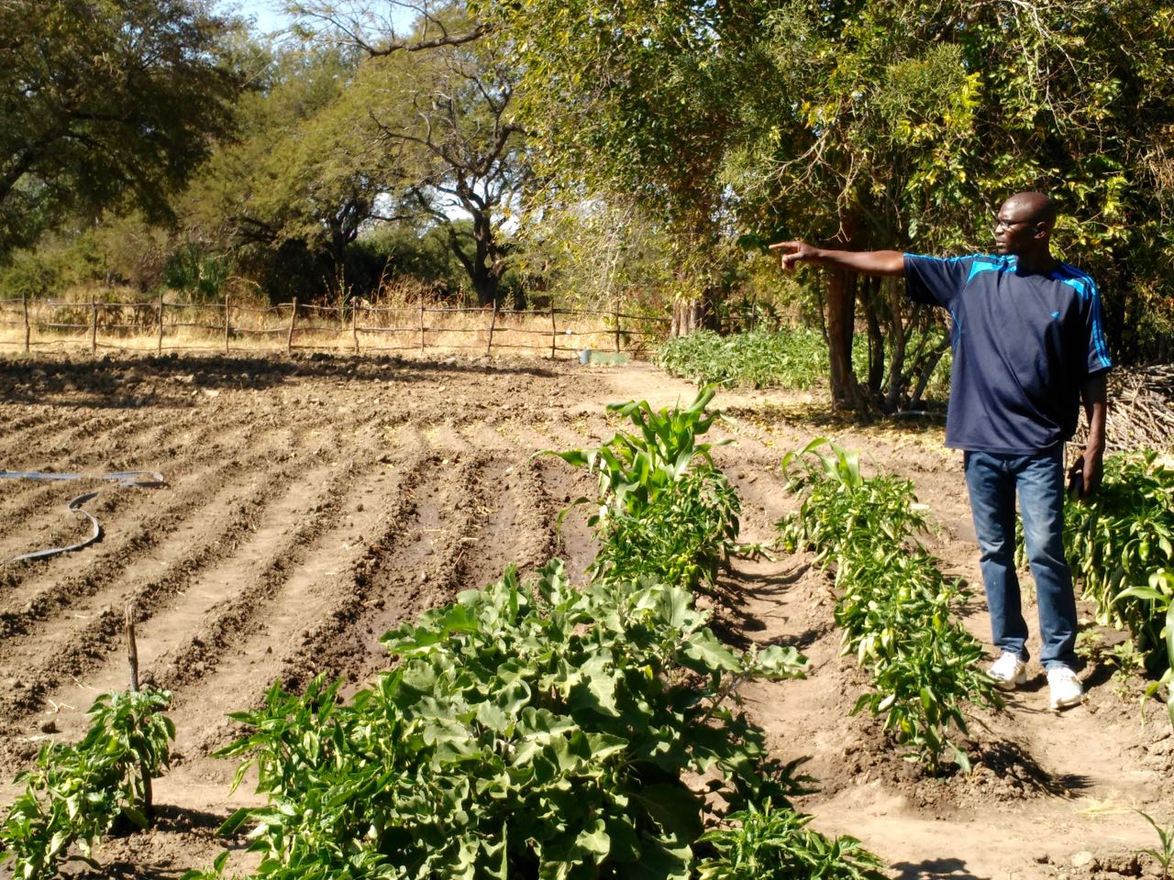
Uses of Formal Climate Information
Notes:
While seasonal forecasts enable rural Zambians to take some precautionary measures, many people are left with great uncertainty as to when specifically these events will occur.
For this reason, Zambians living in communities in Kazungula depend equally, if not more, on traditional mechanisms for predicting floods and droughts.

Slide 11
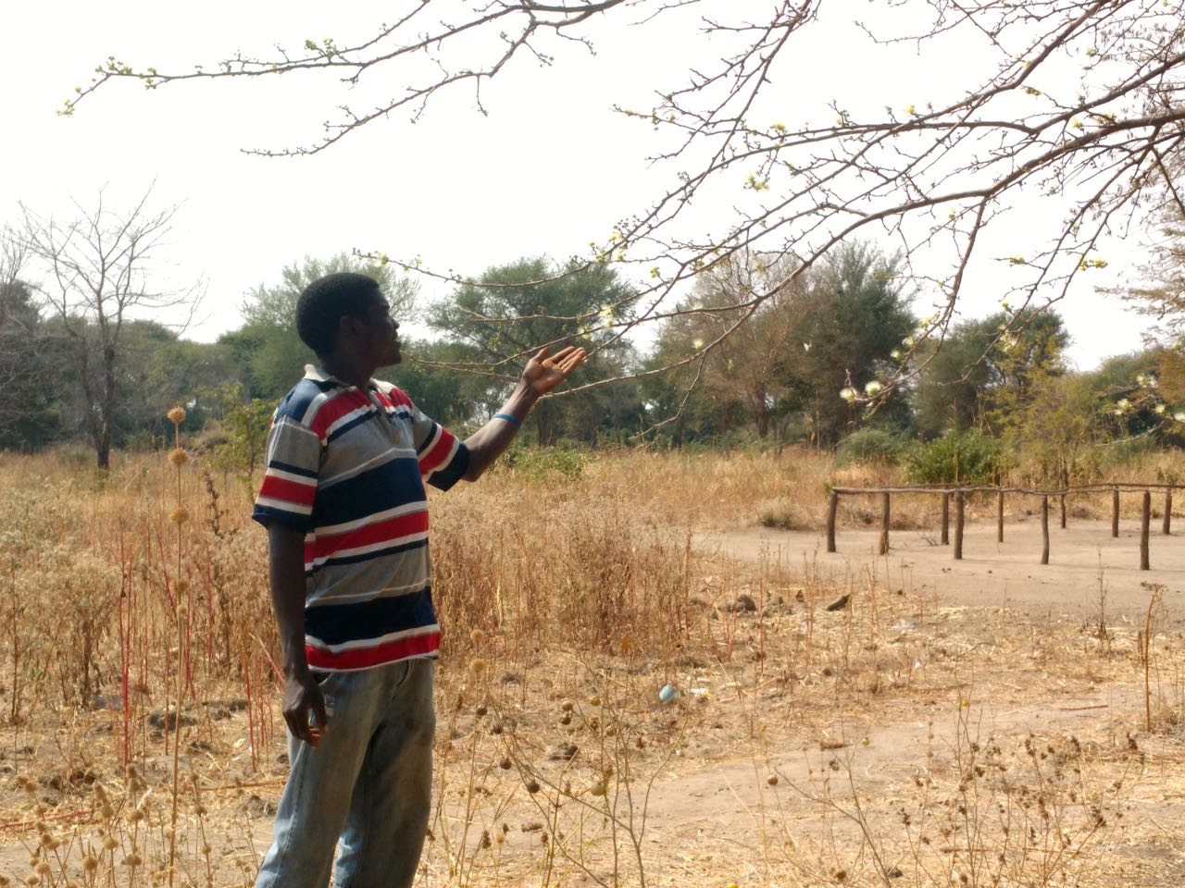
Traditional Mechanisms for Predicting
Disasters
Notes:
MOST COMMON ENVIRONMENTAL INDICATORS OF FLOODS AND DROUGHTS
COBWEBS
By far the most common was the significance of cobwebs suspended in the atmosphere as a portent for impending floods. Although the precise details of how these cobwebs emerge and the timing from when they are visible until a flood occurs remains unclear, informants consistently cited the presence of these nets of whitish silk that hover in the atmosphere as one of the surest signs of inundation. Similar phenomena of spiders escaping floodwaters on winds have been documented in places as diverse as Australia and Pakistan.
Here in Zambia, when the webs are transported on northwest winds coming from upstream and settle onto trees in the bush, people can reliably expect floods in a short time. In fact, several people were so confident that every time they see these webs they will get flooded, that this sign alone is cause for relocation to the uplands. One informant who had lost his home and 39 animals in the devastating 2006 flood, said that he had seen the cobwebs prior to that event and so when he saw them again in 2008 took early action to prevent more loss. Sure enough, by February another devastating flood had struck the region.
SWALLOWS
Residents also pay close attention to the movement of birds, especially swallows or tumbeambe. When seen in large numbers and moving in unison, residents know that heavy rains are on their way.
RATS
In the months and weeks leading up to a major drought, people described large numbers of rats emerging from the bush and invade houses and fields, consuming all food sources available.
TREES
Mango Flowers
-When mango trees flower profusely in July, there will be “enough rains”—and likely floods—during the year.
Baobab and Masuku Fruit
Individuals also reference the fruit of the baobab and masuku trees as environmental indicators of rainfall; if their fruit is profuse, one can expect drought. If it is sparse, there will be significant rain.
Timing that Leaves are Shed
Furthermore, local residents watch the timing that trees shed their leaves leading up to the dry season to anticipate its intensity. Since at the time of this research, conducted in late July, many trees were still hanging onto their leaves, residents suggested they could expect rain and anticipated some relief from the long drought they have been suffering.
CLOUDS AND WIND
While many of these environmental indicators are more useful for anticipating seasonal shifts in precipitation then impending disasters, people predict more immediate weather patterns by watching the formation, movement and type of clouds on the horizon. This, in tandem with studying wind direction, can be used to predict rains within a window of a few days.
WATER TABLE
Residents also described how watching the water table in their deeper wells also provided some advance warning to floods. Often, people explained, the day before a flood the water in their wells becomes cloudy due to seepage.
RESIDENTS PREDICT FLOODS THIS YEAR
“Everything is telling us that there will be rain this year,” one focus group participant in Sikaunzwe expressed. Such certainty exists even without the seasonal forecast from the ZMD.

Slide 12
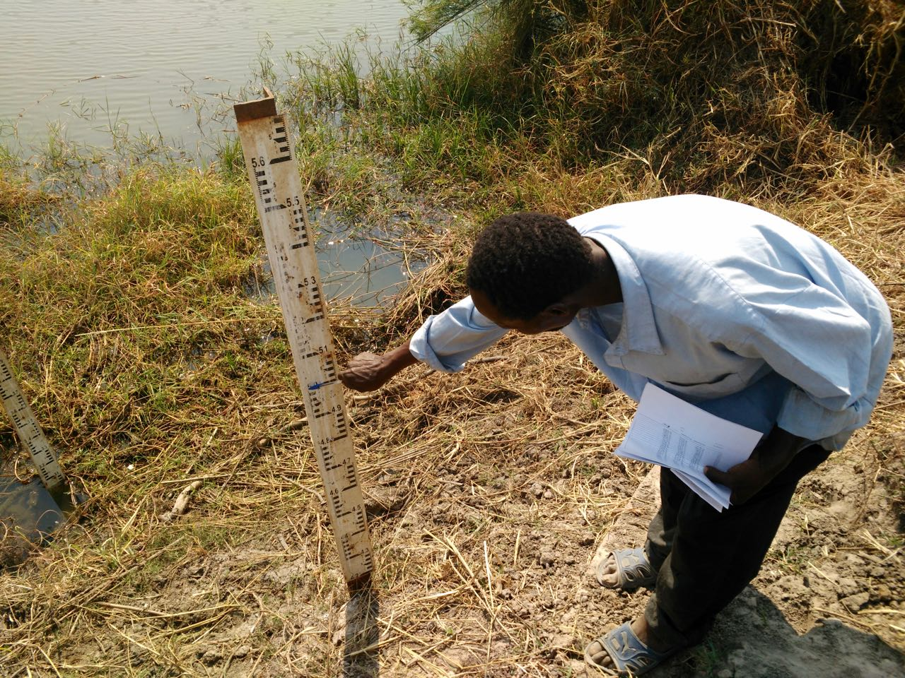

Formal Data vs. Traditional Ways of Knowing
Notes:
Most residents rely on both formal and traditional sources of information for anticipating floods and droughts and in guiding their adaptive strategies.
Mixed responses re: which source of information trust most.
Most people valued having access to government forecasts, but approached them with varying degrees of skepticism.
It was only in Kasaya, however, that people were on the verge of losing faith in formal data, after the ZMD forecast for the previous season indicated good rains that never came. Since people had wholeheartedly embraced the forecast despite contrary indicators in the landscape, they had lost certain crops. This year, people asserted that they would rely on their own methods if their local predictions contradicted the ZMD’s forecasts.
Even among those individuals who asserted that ZMD forecasts were essential to their decision-making, no one had fully abandoned or lost traditional ways of anticipating climatic conditions. Rather, they seemed to find the greatest value in supplementing their indigenous ways of knowing with improved scientific climate data.
However, many residents feel that their ability to use environmental indicators to anticipate floods and droughts is becoming more and more difficult with climate change.
Exiting integration of both sources of knowledge:
When the Kazungula agriculture extension holds meetings to disseminate the ZMD’s seasonal forecasts, he also asks villagers to share how they expect the season to be based on local environmental indicators. Together he and community members analyze to what extent the multiple sources of information match or provide contradictory evidence.

Slide 13
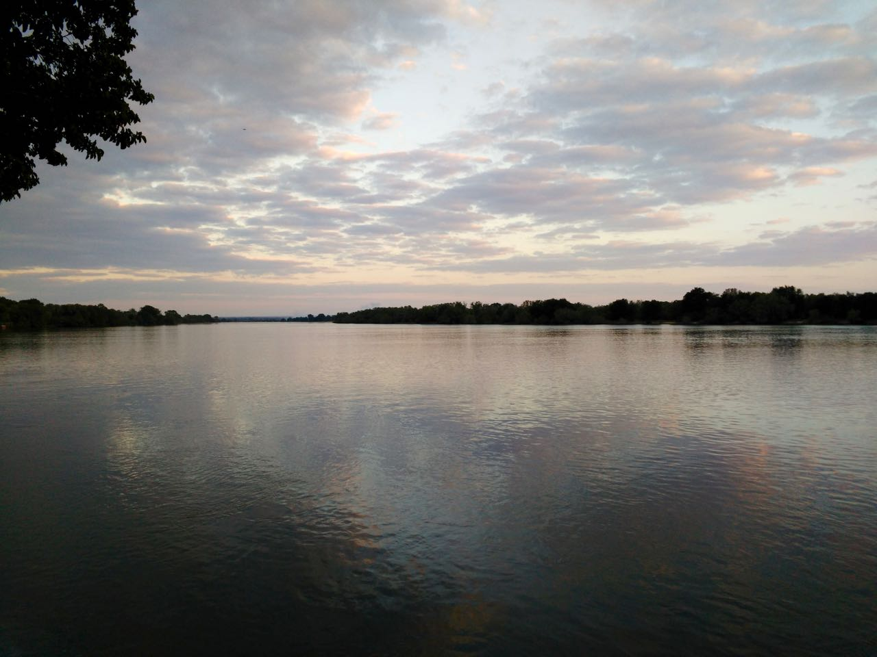
Formal Early Warning Systems
Notes:
Lack of Government Dissemination of Info via EWS
-people do not get precipitation data from ZMD in upstream or live river level data in upstream from Water Affairs/WARMA
-even data from meteorology stations and live gauges not being distributed locally by government, with government institutions only interested in extracting information
-thus far, only NGOs interested in sensitizing communities/mobilizing data locally
NGO Interventions after 2006 and 2008 floods
There has been some interest in setting up more formal EWSs at the community level, particularly in the aftermath of the series of devastating floods which struck communities in the Zambezi floodplain in 2006 and 2008.
Red Cross
-trained 40 people in 2014 as part of ZRBI program
-Red Cross EWS training content: when receive info from ZMD, need to disseminate
-SDMCs would formally call the headman and then they would disseminate the info among the community with assistance from SDMC members
-haven’t used info relayed through EWS training/put in action
CBNRM
-placed river gauges at various locations including Kasaya bridge, Kasaya School, Singendende and rain gauges in Ngwezi mala and Simalaha (most affected communities on banks of the Zambezi in the floodplain, primarily fishing camps)
-data collection volunteer based
-people trained in how to use instruments, collect data, ID normal levels
-used to have monthly meetings with ZMD and Water Affairs who received data
-Data was disseminated locally only via community meetings -when project finished handed over to Water Affairs and ZMD, not sure if data still being collected or used
Epilogue to Interventions
-Communities never faced a major flood while the formal EWSs were in place.
-Since the interventions have phased out, most of the gauges placed in communities have been damaged, the NGOs have never returned to replace them, the government institutions responsible for assembling locally collected data have turned over, and those who were trained to disseminate early warnings have spent the past years more concerned about droughts and their withered crops than inundation

Slide 14
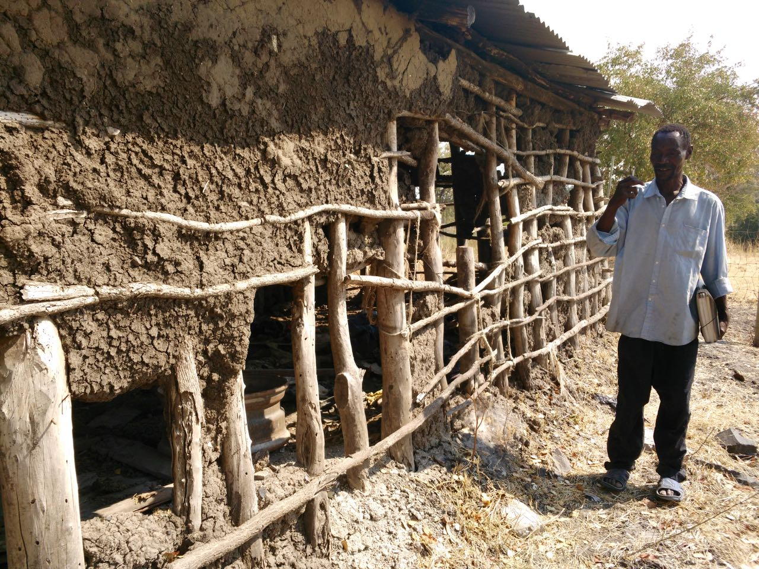
Limits of Existing Interventions
Notes:
LIMITS OF EXISTING EWS INTERVENTIONS
-most interventions focused almost exclusively on the dissemination of forecasts from the ZMD, overlooking the limits of the actual data provided by the ZMD, the barriers to relaying it on the ground, and the actions people would be capable of taking even with an early warning.
-many of the actions were hypothetical, if you have megaphones or sirens you should use them to alert people in the community
-trainings did not work with communities to identify specific actions linked to danger thresholds based on live river data or reliable information from upstream villages.
-no effort to coordinate a specific list of contact people to call in the event of an emergency nor the establishment of collective safe shelters or land on higher ground.
-Most significantly, the trainings involved no component to integrate alternative sources of information from that provided by ZMD (e.g. natural indicators, local knowledge from upstream communities) that might also inform early action
-interventions largely ignored existing mechanisms for sharing information locally between upstream and downstream communities that might be used in the absence of a reliable cell phone network and radio signal.
BARRIERS TO FORMAL EWSs MORE BROADLY
Institutional
-ZMD’s capacity: limited number of weather stations and ability to collect data is a significant challenge
-volunteer collected rainfall data unreliable and lots of turn over with poor NGO exit strategy when hand over gauge readers/stations
-lack of coordinated data/integration between ZMD and Water Affairs/WARMA
-WARMA took over coordinating early warnings/live river data collection in October 2015; since currently only operating from an office in Lusaka, has had a lack of presence on the ground
Communication
-formal advisories from ZMD limited to dissemination by agriculture extension officers
-lack of radios to get information out; also no reliable radio stations in Kazungula to access information
-lack of phone network compromises ability to relay information; MTN generally ok but other providers don’t exist at all in some areas
Exposure
-locally people more focused on increasing droughts/water issues
-since no major floods every season, people become focused on more immediate needs
-gauge readers haven’t used many of the gauges in any flood yet so have not yet established clear thresholds for warnings

Slide 15
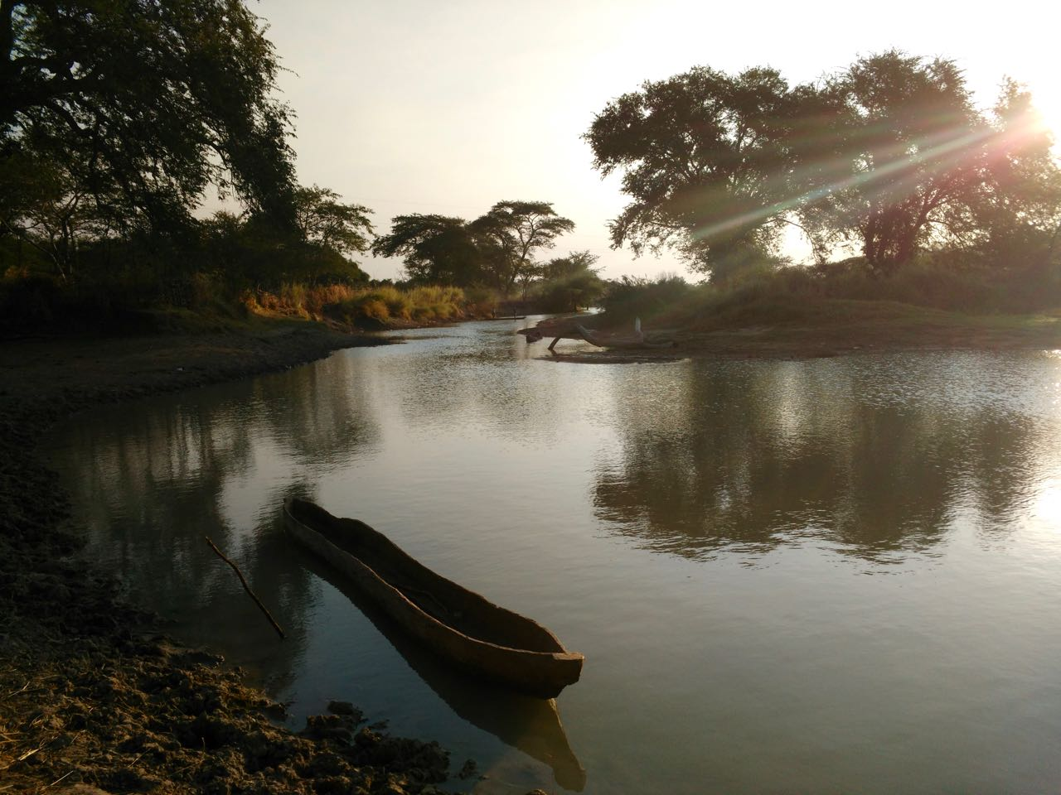
Informal Community-Based Early Warning Systems
Notes:
INFORMAL COMMUNITY-BASED EWS
-in absence of timely flood advisories or formal EWS, local communication chains provide an implicit structure for conveying critical information that, although imperfect, continues to function as the only early warning system people can rely on
-in upland people watch how water advances up trunk of certain designated trees and how aligns with flood extent
-since villages are situated linearly along small tributaries that run into the Zambezi River, those located on the floodplain usually have other villages upstream that they depend on for informal information on upstream precipitation and water levels.

Slide 16
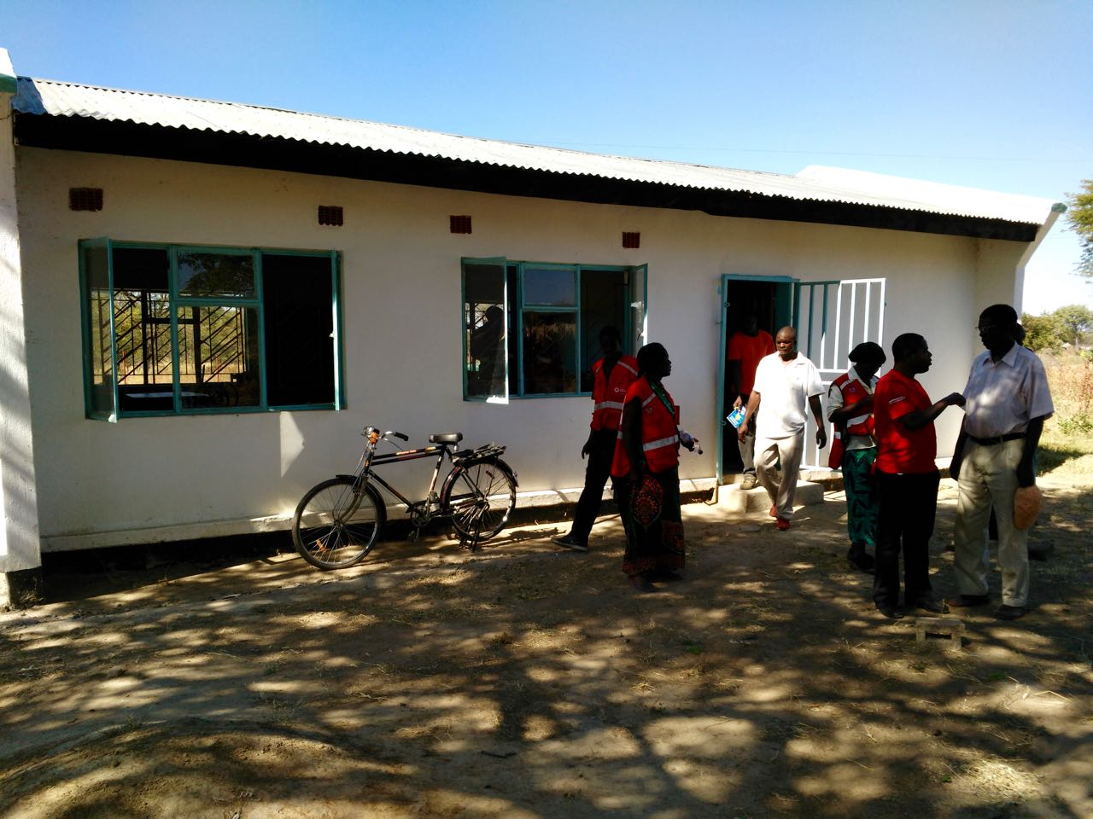
Traditional Communication Strategies for Exchanging Critical Information
Notes:
Local/Traditional Communication Strategies for Exchanging Critical Information
In Sikaunzwe, Kawewa, Kasaya and Simalaha, all communities are linked through informal communication systems to people upstream.
Depending on the location and reliability of the local cell phone network, some people receive this information by cell phone or text.
However, more common were warnings provided by people traveling downstream on their way to the main road for trade or travel. As they pass through villages on the way to their destination, such individuals share information about conditions in the upstream, including when water has reached a certain level.
This information is then distributed locally by the village headman and his personal messengers, sometimes with the help of SDMCs at whatever village meetings, church congregations, and collective events like funerals already planned.
These venues enable rapid and wide dissemination in places with limited communication infrastructure.
In urgent situations, people sometimes use bicycles to go house-to-house, though this form of transportation is difficult in the rainy season when roads and paths are deeply rutted.
Depending on the type of precipitation event upstream, these method of dissemination can be effective, but in flash flood events they fail to provide adequate lead time.
Examples of How these Informal Communication Structures Function in Specific Communities
Sikaunzwe
The community of Sikaunzwe, situated along the Lingwazee Stream, has been relying on information conveyed from the 52 villages located upstream for more than five years (likely since the MTN cell phone network became reliable enough to make phone calls). A warning from the furthest village, approximately 15-20 kilometers away, can provide up to a two to three-day lead time before floodwaters strike Sikaunzwe. Interesting, rather than relying on a single individual or instituting a formal structure for disseminating the warning, in this community-initiated early warning system (EWS) any person can call. Although somewhat disorganized, in some ways, this more nebulous system of responsibility ensures resilience in a place where service is spotty, people’s phones are often switched off or out of balance to make calls, and living off the grid makes charging devices a daily challenge. If a more formalized communication structure were established here, where key individuals were responsible for calling others on a list, such barriers to communication would need to be accounted for so that if one person was not reachable there would be a backup person (or two) who could be notified.
Kasaya
People living along the Kasaya River described a similar system whereby they receive information from several villages strung along the waterway 20-25 kilometers upstream. When residents in Kasaya are warned by Silibani, the furthest village they have contact with, the rest of the community is warned by phone (for those who have them), and announcements are made at church and village meetings. Based on these warnings, people prepare to evacuate with their livestock to the uplands, a distance of 10 kilometers from their permanent residence on the Zambezi floodplains. Although imperfect, and certainly not capable of always providing adequate lead time, these links between upstream and downstream communities are the closest thing to an EWS that currently exists on the ground.

Slide 17
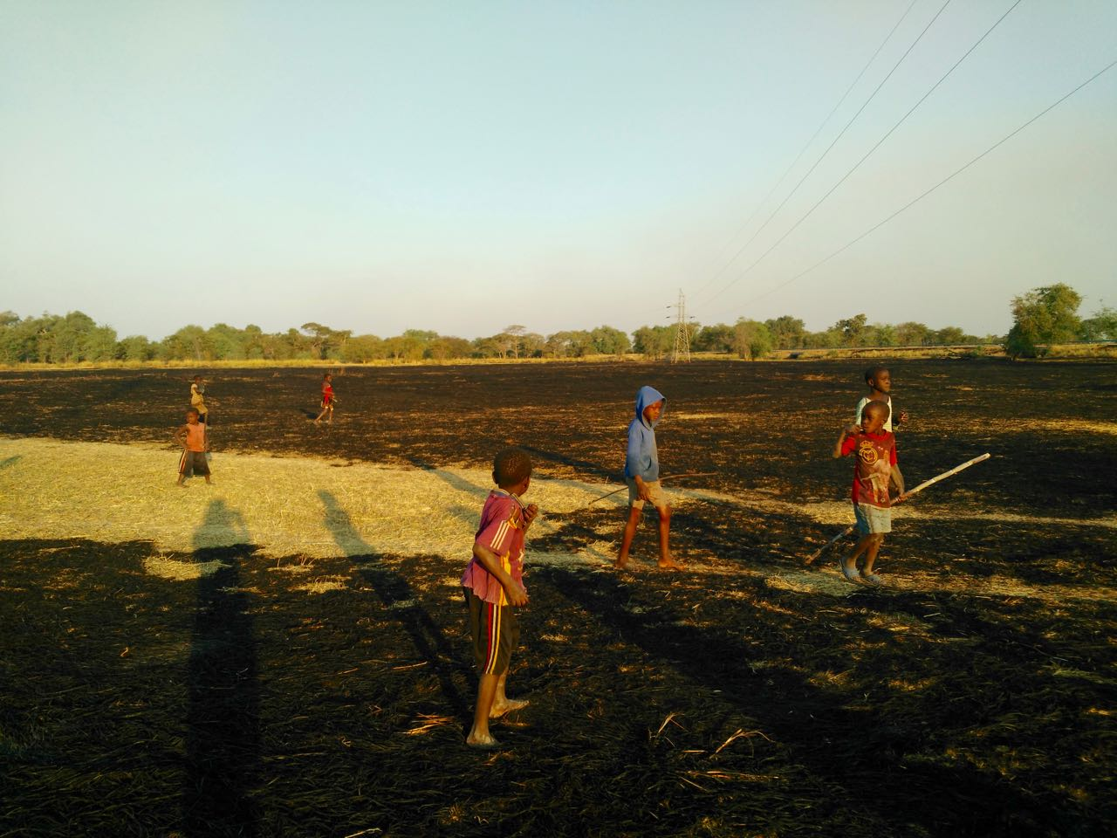
Recommendations
Notes:
Based on this data and my humble reflections, I include some thoughts on opportunities I observed for enhancing existing community-based EWSs through intervention and also for projects to support local adaptive strategies guided by traditional knowledge.

Slide 18
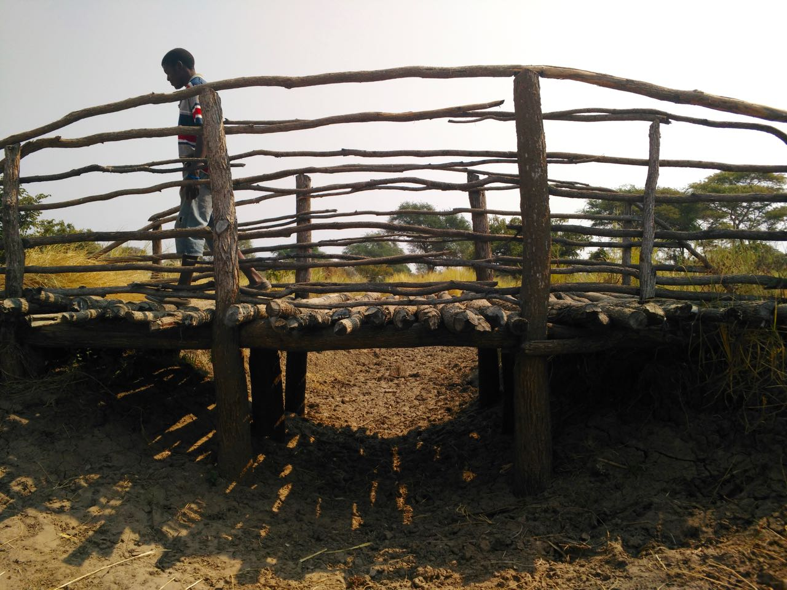
Opportunities for Improving Community Based EWSs
Notes:
OPPORTUNITIES FOR IMPROVING COMMUNITY-BASED EWSs
Based on my reflections, there still seem to be a number of ways in which interventions could support more robust EWSs at the community level even in the absence of formal mechanisms.
LINK EXISTING GAUGES AND TRAINED READERS TO LOCAL/DOWNSTREAM COMMUNITIES
-this would leverage existing gauges/readers currently providing to ZMD and WARMA to provide localized early warnings to communities downstream using SMS where possible and/or the existing informal communication structures discussed above.
There is a gauge at the Kasaya Bridge, for example, that has been operational since 2000. River levels are collected three times daily by a dedicated gauge reader and sent to the district headquarters in Sesheke. Though he has taken it upon himself to advise nearby communities on occasion, using whatever personal contacts he has stored in his phone, there are opportunities for the data he collects to be disseminated more broadly using the existing informal communication structures discussed above. Based on my interviews, both the cellular network and percentage of the population with phones seems sufficient for initiating a more formal structure for transmitting warnings by SMS in tandem with traditional mechanisms to downstream communities.
2. ADD ADDITIONAL GAUGES IN UPSTREAM TO ESTABLISH CLEAR LEADTIMES AND PROVIDE WARNINGS TO MORE COMMUNITIES
-install gauges in upstream to provide more advanced notice based on live river level data for downstream communities
-local involvement in identifying lead times
Even if simple gauges were added along waterways in the headwaters, it would be possible to establish clear lead times between upstream and downstream locations, which would enable people to predict when and how they would be impacted by floodwaters. With a historical record of 16 years at the Kasaya Bridge gauge, including information collected during the 2006 and 2008 floods which residents still vividly remember, it would be feasible to establish specific thresholds linked to preventative actions. For example, the gauge reader at Kasaya explained to me that during the 2006 floods, the river peaked at 7.9 meters, but that whenever the water level reaches five meters, he knows nearby villages will begin to suffer. Leveraging this knowledge to mobilize local action would greatly enhance people’s capacity to prepare for floods and mitigate their losses.
3. ENGAGE AT-RISK COMMUNITIES THROUGH PARTICIPATORY RISK MAPPING AND COLLABORATIVE ESTABLISHMENT OF ACTIONS BASED ON DANGER THRESHOLDS
-participatory mapping would be one technique to sensitize residents to flood risk, but without simply training them/telling them what to do
-through these exercises, safe shelters/areas in the upland could be identified, as well as particularly vulnerable residents (i.e. those with disabilities, elderly) who would need assistance during an emergency
-once lead times are established, communities should be involved in identifying how specific river levels/danger levels translate to impacts in their communities; this information can guide a list of specific actions that can be taken when a warning is relayed from upstream
4. FORMALIZE A CULTURALLY RELEVANT AND PRACTICAL COMMUNICATION STRUCTURE TO RELAY EWS
-although informal communication strategies already exist for relaying information, an intervention (informed by focus groups, etc.) could determine whether or not a more formal structure for communicating warnings/lead times to downstream communities would be useful
-while there may be resilience in a nebulous system where communities share the responsibility for dissemination, coming up with a clear list (and list of back-up individuals and cellular numbers) could greatly improve the effectiveness of existing community-based EWSs
5. PARTNERSHIP WITH MTN NETWORK TO PROVIDE EWSs VIA SMS
-since MTN is by far the most reliable cellular network in the region, and also supports all electronic/email communication in the region, it may be worth investigation partnerships to convey early warnings/flood advisories (either formal from ZMD or informal from upstream communities) via text/SMS

Slide 19
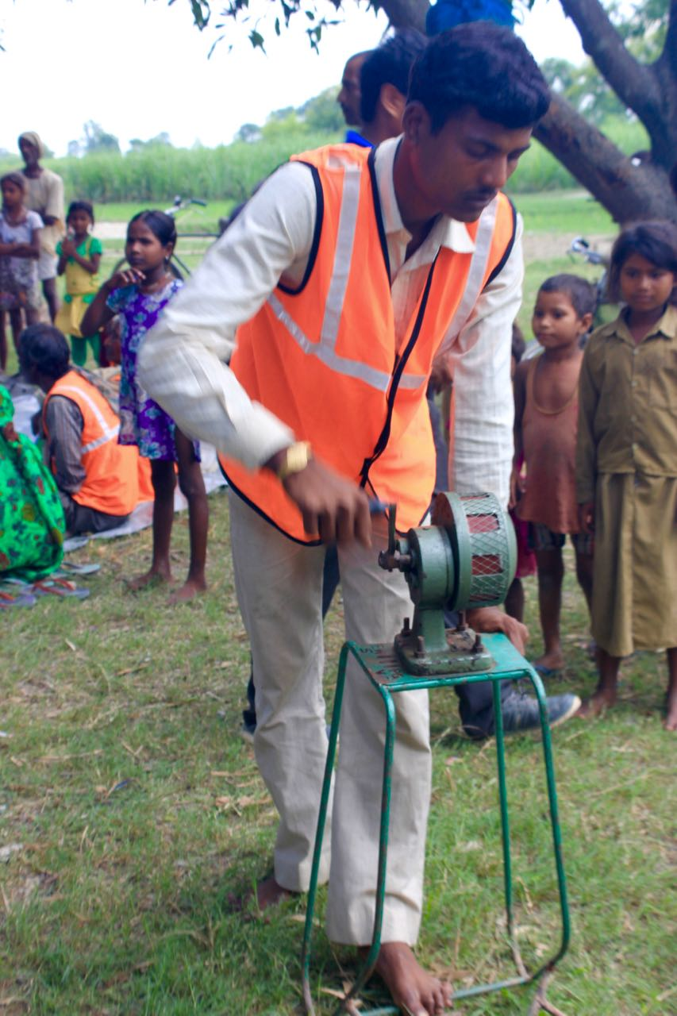
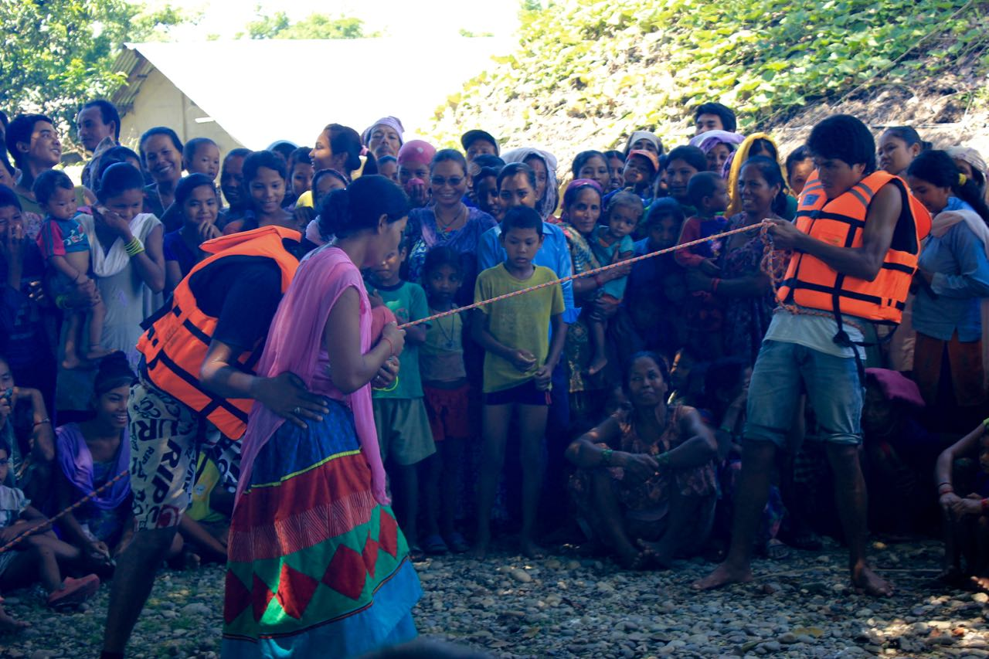
Example of Practical Action’s Community-Based EWS in Nepal and India

Slide 20
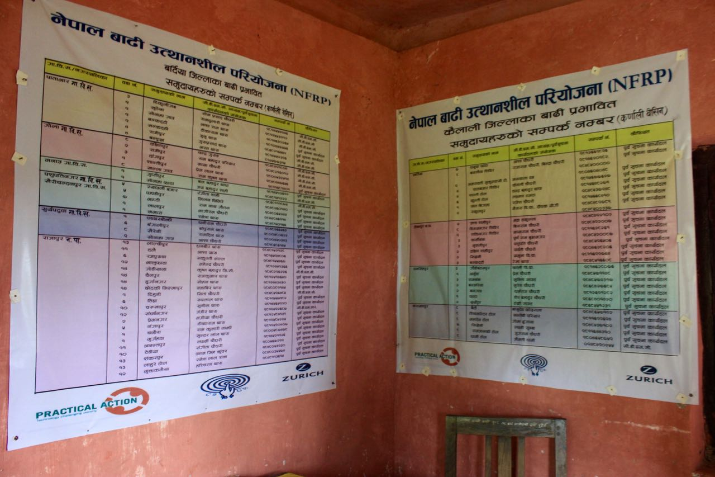
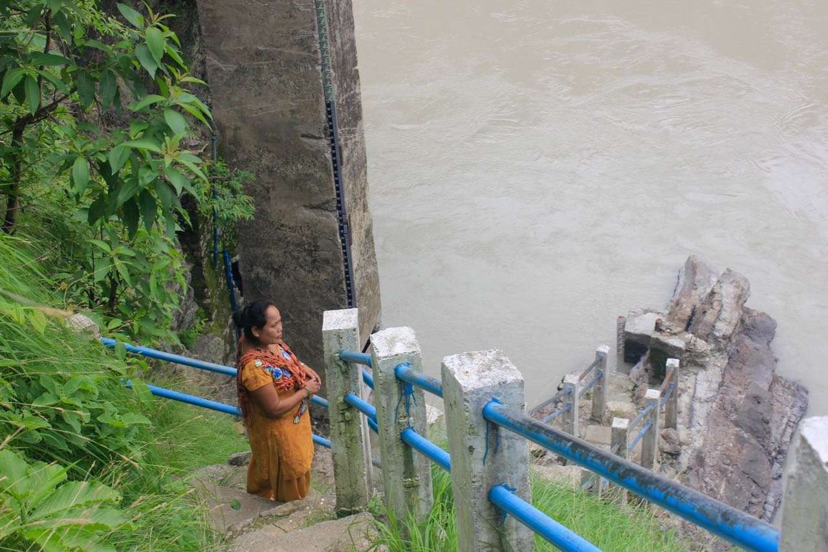
Gauge Reader and Formal Communication Structure

Slide 21
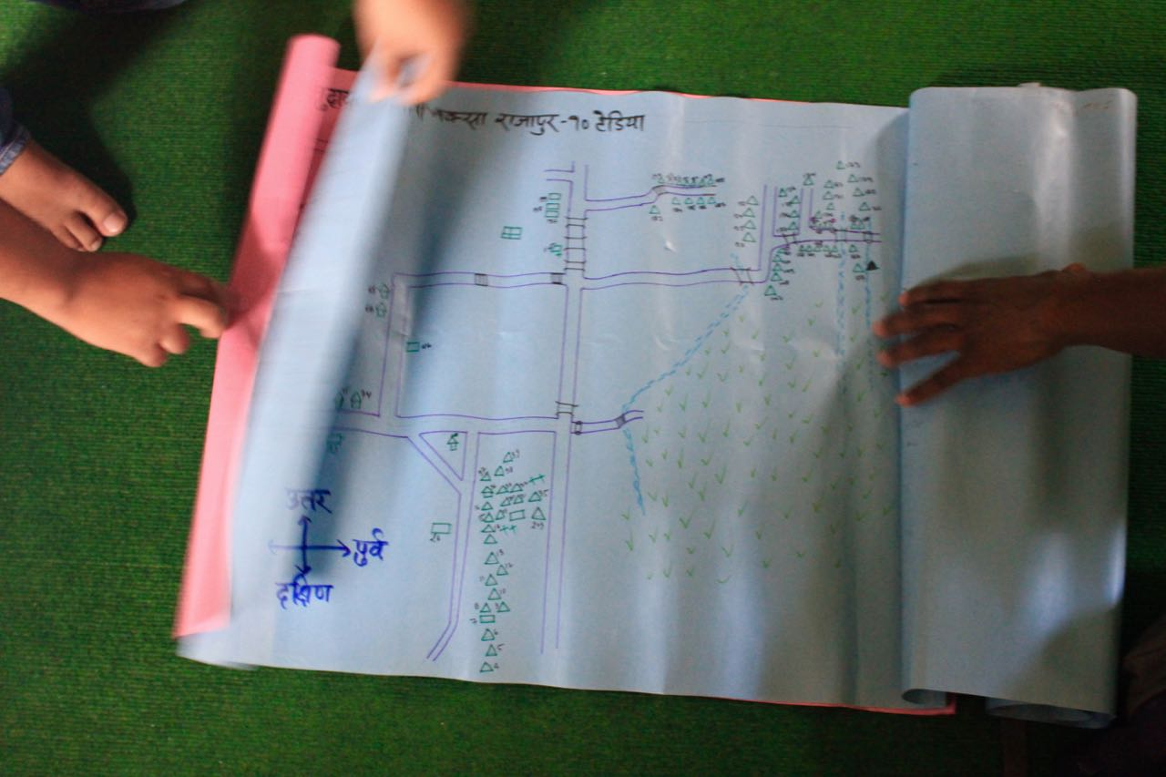
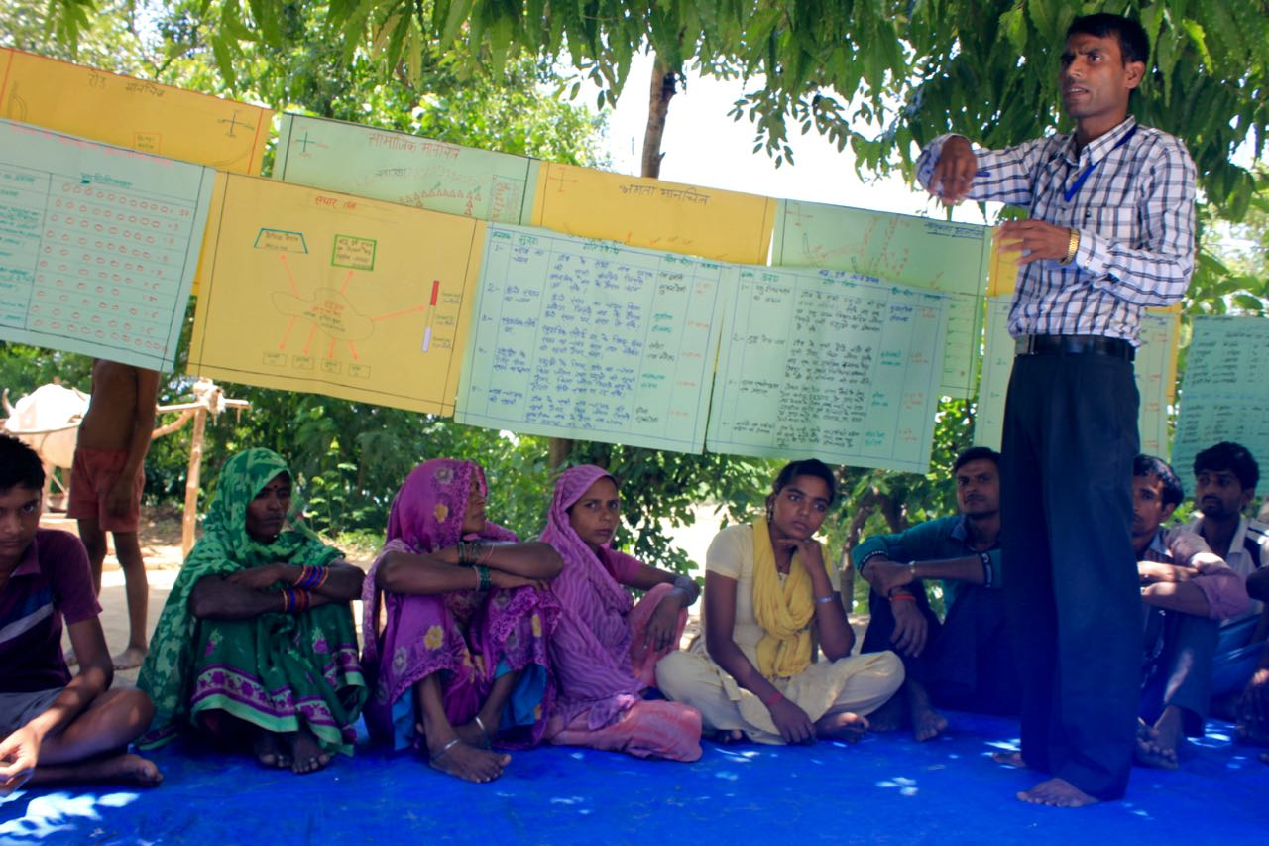
Participatory Risk Maps and Community Meetings

Slide 22
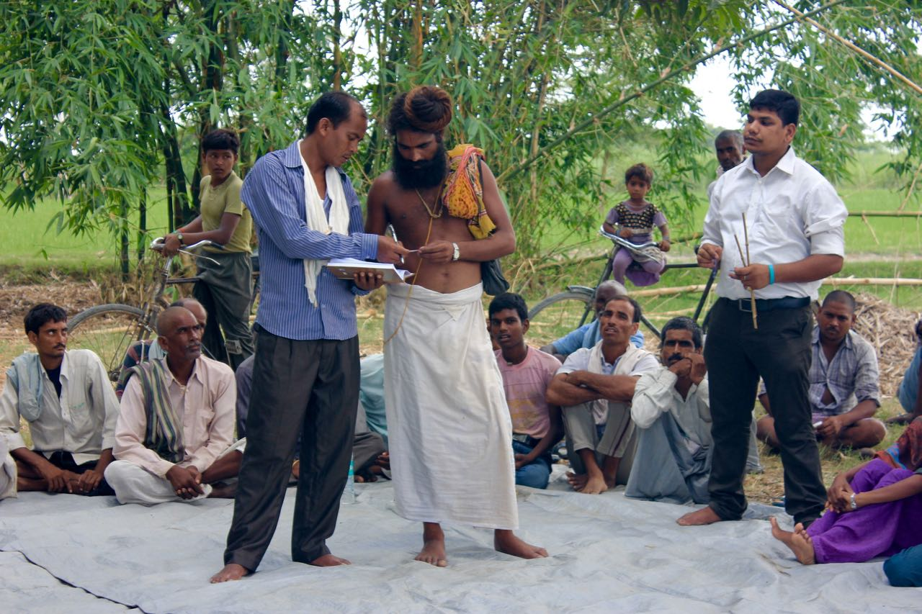
Linking Upstream-Downstream Communities via Cell Phone

Slide 23
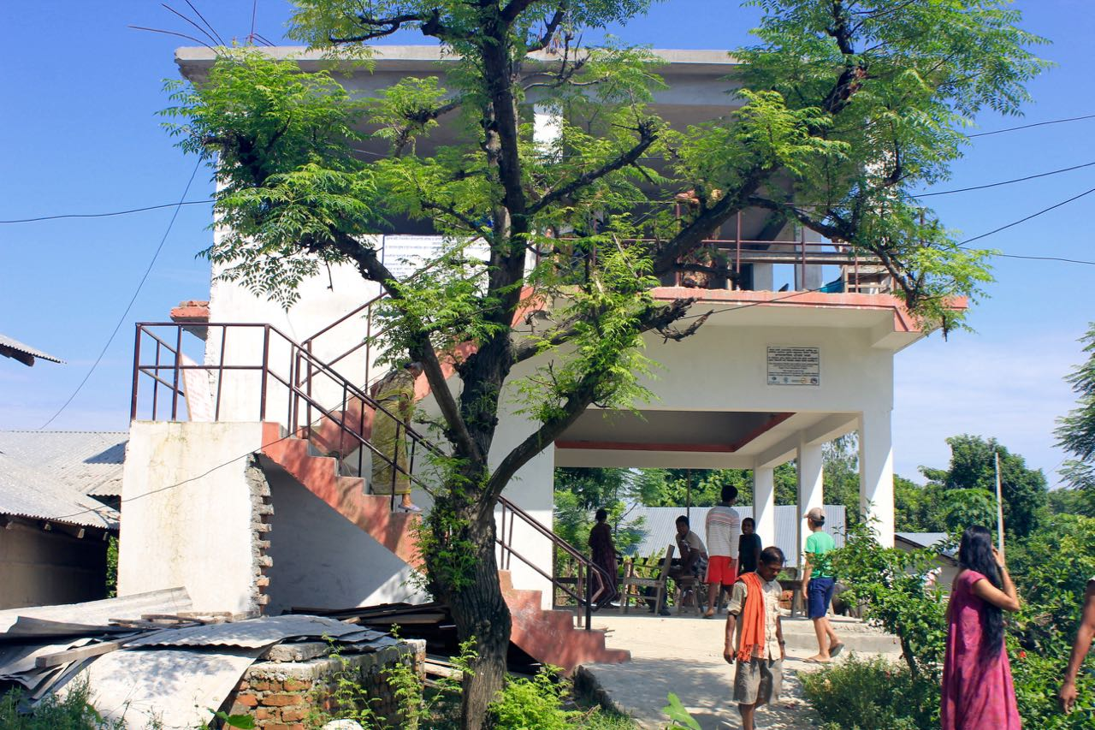
Safe Shelters and Establishment of Evacuation Routes

Slide 24
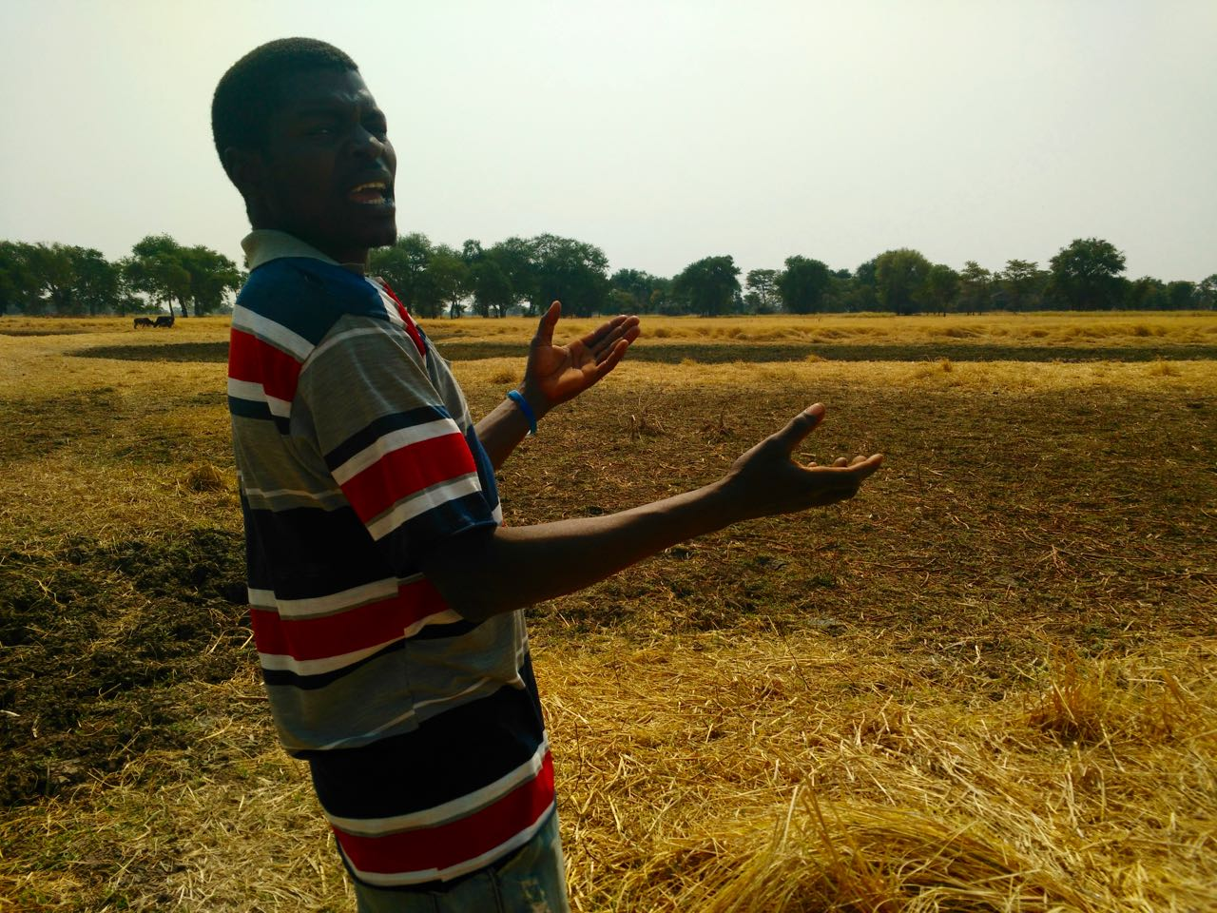
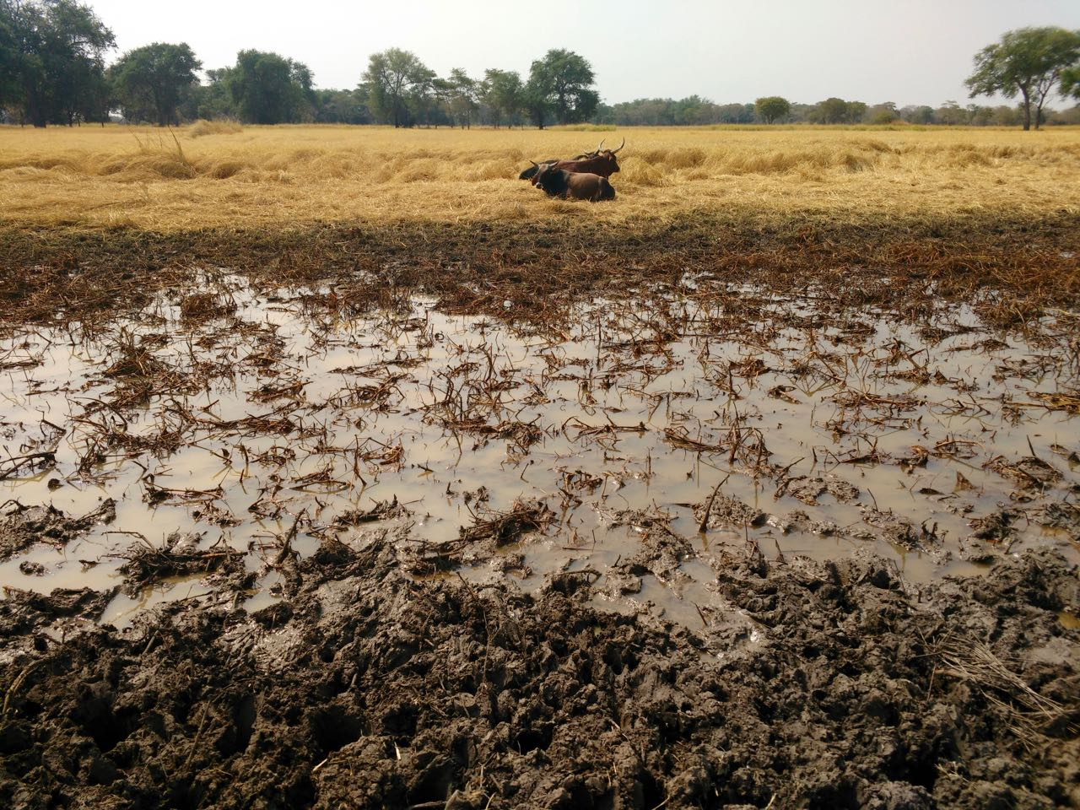
Suggestions for Climate Adaptive Strategies Integrating Traditional Knowledge and Formal Interventions
Notes:
These suggestions for climate adaptive strategies integrating traditional knowledge and formal interventions are based on conversations with residents and key stakeholders. Most of these suggestions are self-identified actions that local residents want to take but require external financial support or technical advice.
CONSTRUCTION AND DEEPENING OF RESERVOIRS
*Recognizes the dual disasters of floods and droughts that communities face
-right now floods occur haphazard and people cannot use the waters, need to make this a resource to secure themselves from droughts
-residents described needing some form of water storage to channel floodwaters into collection ponds to use it for water supply, irrigation, or even rice farming later
Example
-Nakalonzya Dam (near Nduna village in Sikaunzwe)
-this is a natural pond on the floodplain that provides drinking water for both people and livestock but always dries up by September
-with clay soils if it were deepened its water reserve would last longer and ward off suffering from drought
POSITIONING OF STRATEGIC BOREHOLES
-currently significant stress on one borehole located at school in Sikaunzwe
-although water is generally salty in Sikaunzwe, it would not be hard to ID areas without salt (using trees like the munga and mubalota trees, as indicators) to sink boreholes and improve water access
ESTABLISHMENT OF LOCAL SEED BANKS
-maize is a crop particularly sensitive to floods/droughts
-also people had almost completely given up growing sorghum 10 years ago and other indigenous drought resistant crops since many people are switching to hybrids which sell better on the market
-need to set up seed banks and collect indigenous/ OPV (open pollinated varieties) crops to ensure local varieties are not lost

Slide 25
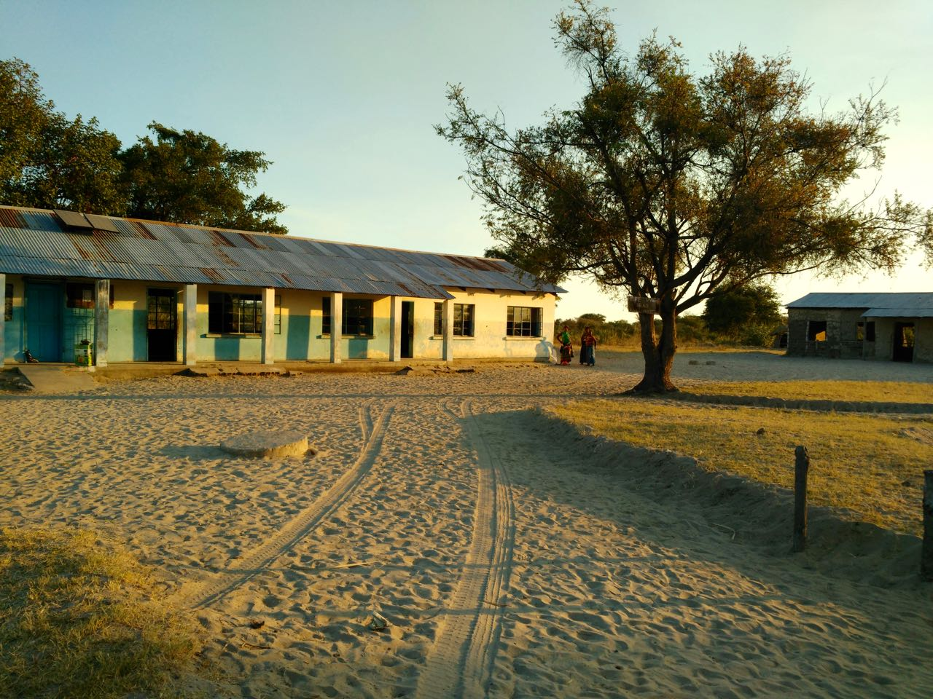
Conclusion

Slide 26

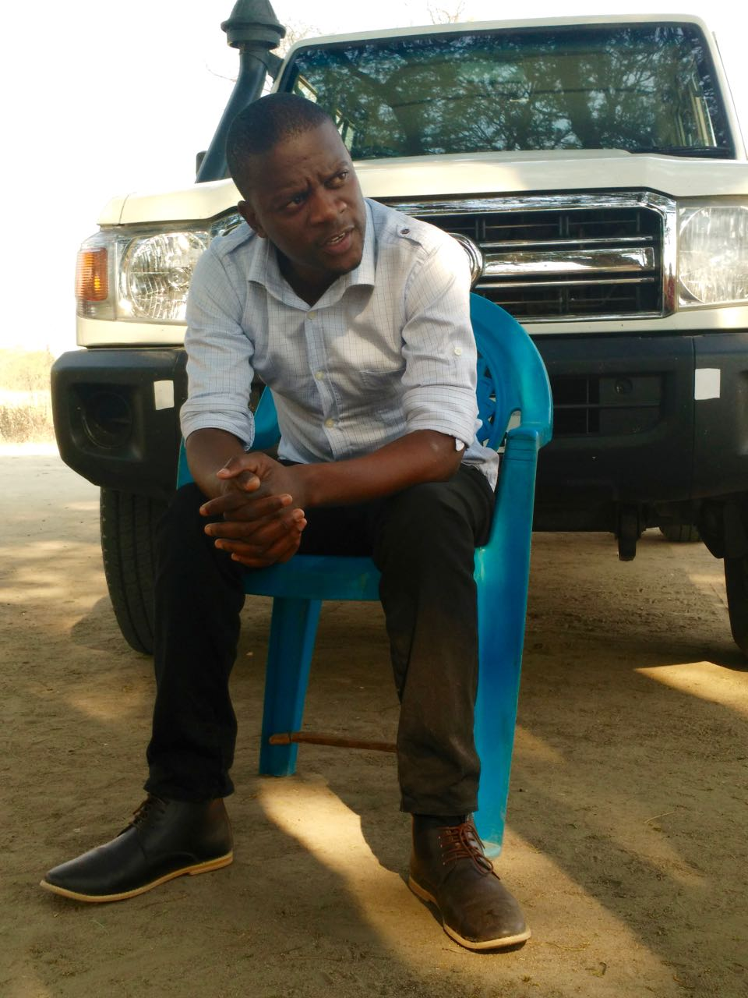
Acknowledgements
Notes:
This research and analysis would not have been possible without the support of the following institutions and people:
-Red Cross Red Crescent Climate Centre, especially Bettina Koelle for providing support throughout this internship
-The University of Colorado Boulder and the Center for Science & Technology Policy Research, in particular Max Boykoff, Arielle Tozier de la Poterie, and Meaghan Daily for constant support
-Zambia Red Cross Society, in particular Wisford Mudenda and Samuel Mutambo, for logistical support and planning
-Emmanuel Mudenda (District Project Officer) and Zumbo Mbambara (Kazungula Branch Volunteer) for facilitating logistics in the field including transportation, data collection and translation support
I am so grateful!

